Slide 1

The Imperial Management
HOTEL APPLICATION
Krishal, Sanjit and Cara

Slide 2
SCOPE To create an Android Application for Housekeepers, Management and Front Desk staff within the Accommodation Industry to use in order to lessen time used to report a room status. Aim To create order and reduce loss of time for Housekeepers and Management within the Accommodation Industry. Objectives 1] Research current methods used within the Accommodation Industry in respect to room maintenance. 2] Design, create and test an Android Application. 4] Design and create a database.

Slide 3
MOVs 1] OPERATIONAL IMPACT – Our applications will make communication faster for the Housekeepers and Front Desk staff as it will allow communication in both directions to be done in real-time, without them having to travel to find the person(s) they wish to report to. 2] CUSTOMER 3] FINANCE

Slide 4
EXISTING SYSTEMS

Slide 5
METHODOLOGY

Slide 6
Risks and mitigation

Slide 7
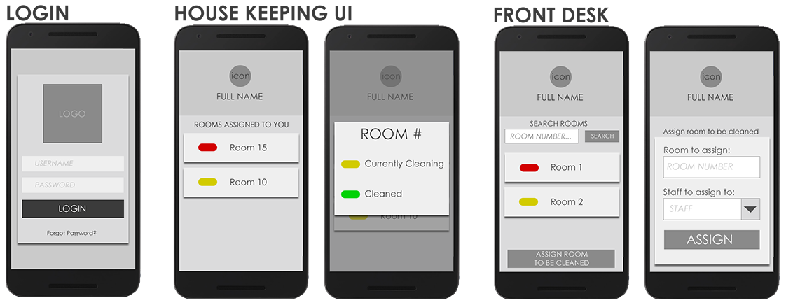
DESIGN UI

Slide 8
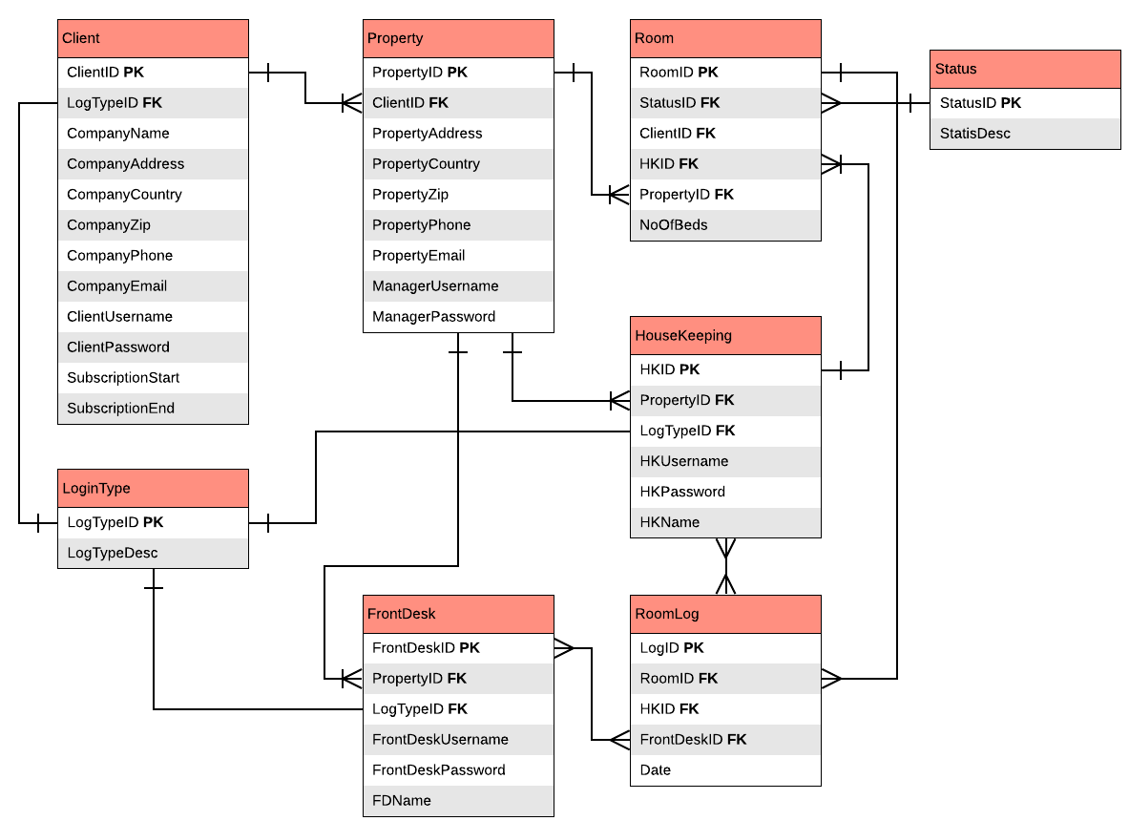
ERD

Slide 9
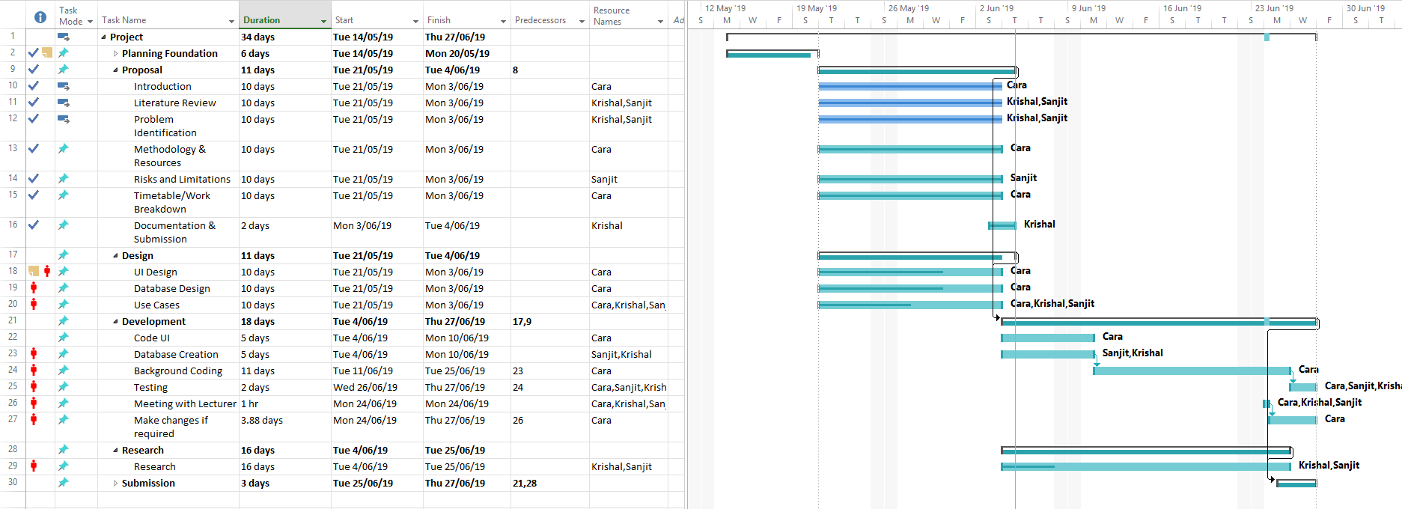
GANTT CHART

Slide 10

Thank you

Slide 11
REFERENCEs

